Slide 1
Project on Telecommunication churn
Objective:
Customer churn is a big problem for telecommunications companies. Indeed, their annual churn rates are usually higher than 10%. For that reason, they develop strategies to keep as many clients as possible. This is a classification project since the variable to be predicted is binary (churn or loyal customer). The goal here is to model churn probability, conditioned on the customer features.
Dataset details:
Data Set Details: The data file telecommunications_churn.csv contains a total of 19 features for 3333 customers. Each row corresponds to a client of a telecommunications company for whom it has been collected information about the type of plan they have contracted, the minutes they have talked, or the charge they pay every month.

Slide 2
The data set includes the following variables:
“Account length”, “ voice mail plan”, “voice mail messages”, “day mins”, “evening mins”, “ night mins”, “international mins”, “ customer service calls”, “international plan”, “ day calls”, “ day charge”, “evening calls”, “evening charge”, “night calls”, “night charge”, “international calls”, “international charge”, “total charge”
Churn:
This is the target variable. It is the one that determines whether the client is still in the company or not. (1-Churn, 0-No Churn)
Importing Libraries:
Such pandas, numpy, matplotlib.pyplot, seaborn etc., which we gonna use in EDA.
Importing Dataset:
Now, we import the telecommunication churn dataset from pandas.

Slide 3
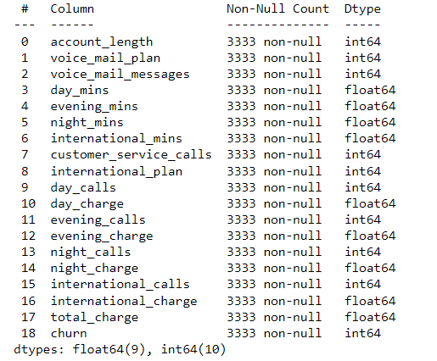
Exploratory Data Analysis (EDA)
1.) There are 3333 Rows and 19 columns
2.) We check the data types and nullability of columns

Slide 4
As shown in the table, the data set contains 3333 observations and 19 columns. Apparently, there are no null values on the data set.
 | Account length | Voicemail plan | voicemailmessages | Day mins | Evening mins | nightmins | Internationa mins | Custome service calls | International plan | Day calls | Day charge | Evening calls | Evening charge | Night calls | Night charge | International calls | International charge | Total charge | churn
count | 3333.000000 | 3333.000000 | 3333.000000 | 3333.000000 | 3333.000000 | 3333.000000 | 3333.000000 | 3333.000000 | 3333.000000 | 3333.000000 | 3333.000000 | 3333.000000 | 3333.000000 | 3333.000000 | 3333.000000 | 3333.000000 | 3333.000000 | 3333.000000 | 3333.000000
mean | 101.064806 | 0.276628 | 8.099010 | 179.775098 | 200.980348 | 200.872037 | 10.237294 | 1.562856 | 0.096910 | 100.435644 | 30.562307 | 100.114311 | 17.083540 | 100.107711 | 9.039325 | 4.479448 | 2.764581 | 59.449754 | 0.144914
std | 39.822106 | 0.447398 | 13.688365 | 54.467389 | 50.713844 | 50.573847 | 2.791840 | 1.315491 | 0.295879 | 20.069084 | 9.259435 | 19.922625 | 4.310668 | 19.568609 | 2.275873 | 2.461214 | 0.753773 | 10.502261 | 0.352067
min | 1.000000 | 0.000000 | 0.000000 | 0.000000 | 0.000000 | 23.200000 | 0.000000 | 0.000000 | 0.000000 | 0.000000 | 0.000000 | 0.000000 | 0.000000 | 33.000000 | 1.040000 | 0.000000 | 0.000000 | 22.930000 | 0.000000
25% | 74.000000 | 0.000000 | 0.000000 | 143.700000 | 166.600000 | 167.000000 | 8.500000 | 1.000000 | 0.000000 | 87.000000 | 24.430000 | 87.000000 | 14.160000 | 87.000000 | 7.520000 | 3.000000 | 2.300000 | 52.380000 | 0.000000
50% | 101.000000 | 0.000000 | 0.000000 | 179.400000 | 201.400000 | 201.200000 | 10.300000 | 1.000000 | 0.000000 | 101.000000 | 30.500000 | 100.000000 | 17.120000 | 100.000000 | 9.050000 | 4.000000 | 2.780000 | 59.470000 | 0.000000
75% | 127.000000 | 1.000000 | 20.000000 | 216.400000 | 235.300000 | 235.300000 | 12.100000 | 2.000000 | 0.000000 | 114.000000 | 36.790000 | 114.000000 | 20.000000 | 113.000000 | 10.590000 | 6.000000 | 3.270000 | 66.480000 | 0.000000
max | 243.000000 | 1.000000 | 51.000000 | 350.800000 | 363.700000 | 395.000000 | 20.000000 | 9.000000 | 1.000000 | 165.000000 | 59.640000 | 170.000000 | 30.910000 | 175.000000 | 17.770000 | 20.000000 | 5.400000 | 96.150000 | 1.000000

Slide 5
After viewing the basic statistical details of the data. We can observe that:
The average number of minutes a person is talking on the phone in day, evening and night is almost same.
The average number of calls made during the day, evening and night is almost same.
Again, the day charges are higher as compared to the evening and the night charges.
We can draw a conclusion here that Day, Evening and night charges are in the ratio 4:2:1.
Checking Duplicated Values:
As we found out there are no duplicate values are present in the given dataset.
Data Visualization:
With the help of seaborn library, we did visualization.

Slide 6
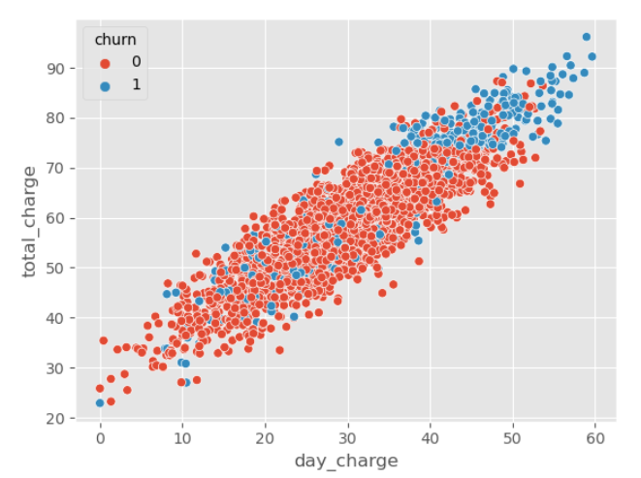
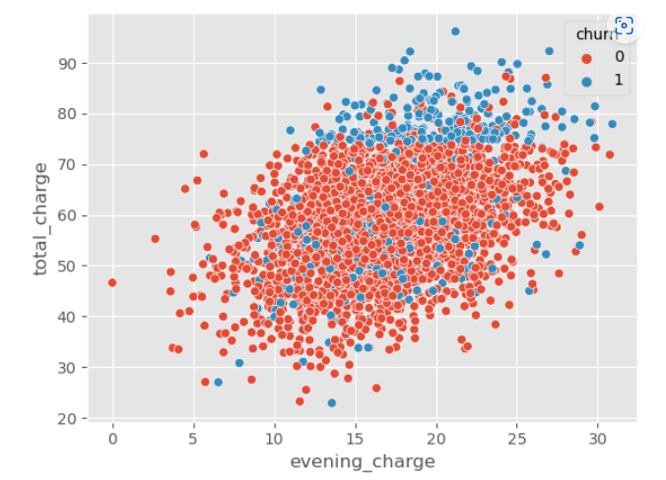
Total charge VS day charge Total charge VS evening charge

Slide 7
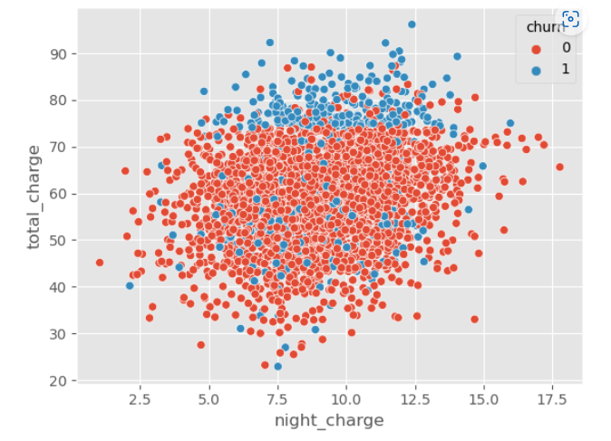
By looking at the above plot we can observe that:
Day charges are highly postively related to the total charge.
Evening charges are less related to the total charge.
Night charges are the least which is related to the total charge.

Slide 8
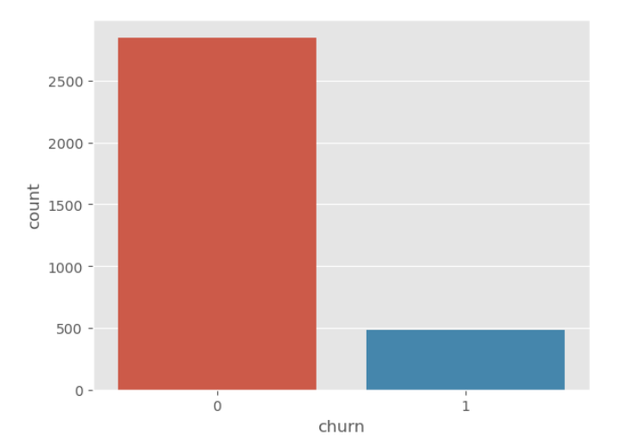
Churn VS Non-Churn :
The above bar plot shows the percentage of observations that correspond to each class of the response variable: no(0) and yes(1). This is an imbalanced data set because both classes are not equally distributed among all observations, being no the majority class more than 83%. When modeling, this imbalance will lead to a large number of false negatives.
By this we can also conclude that:
Churn vs Non-churn customers ratio is 1:6
Churn minority class - 483 customers
Non-churn - majority class - 2850 customers

Slide 9
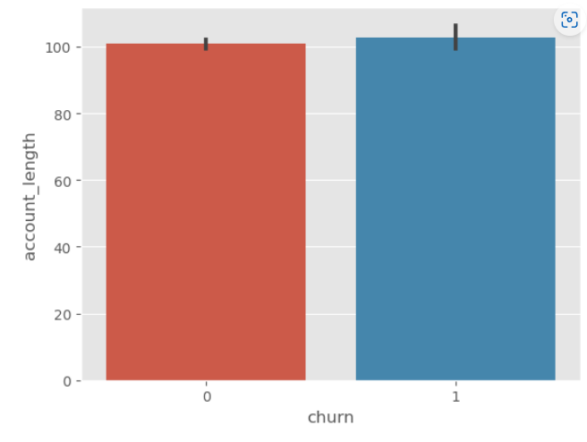
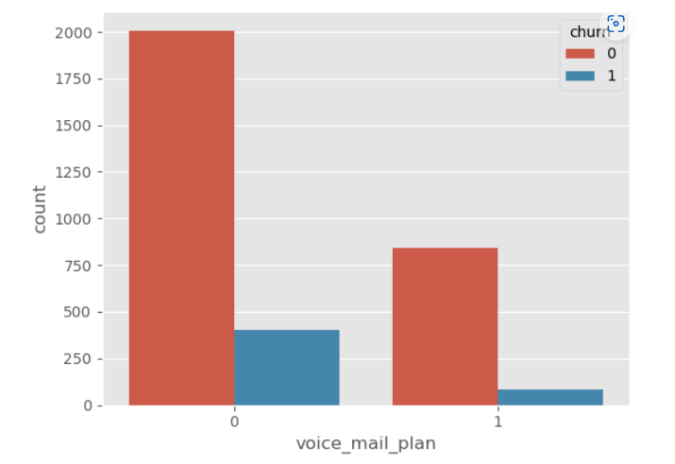
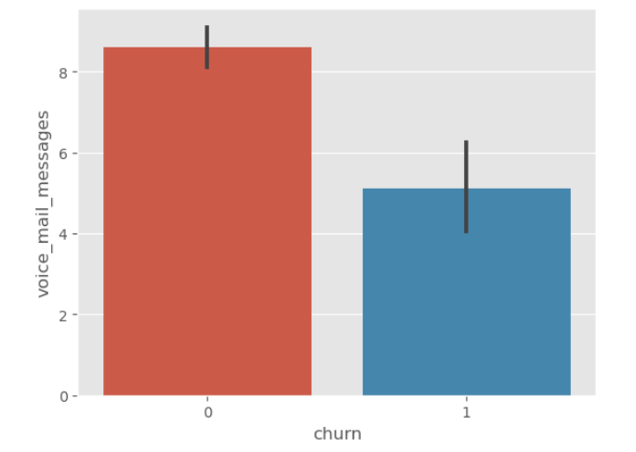
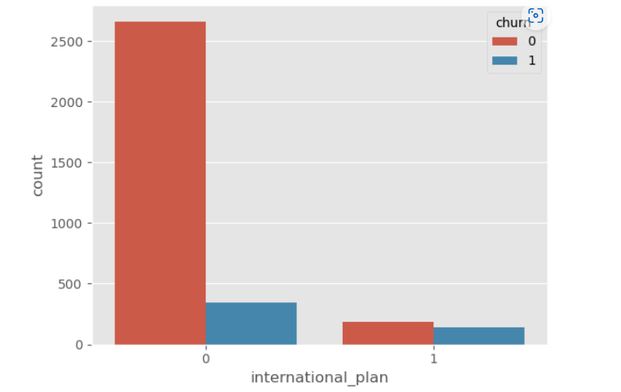

Slide 10
The above bar plot 1 clearly shows that the account lenght has no effect on churning rate of customer. We may condisder dropping this feature from the data set in future.
We can see that in bar plot 2, customer who does not have voice mail plan are the highest churner. Also, we can see below that how many customers are churners and non-churners.
By looking at the above bar plot 3, we can observe churn customers have less number of Voice Mail Messages
By looking at the above bar plot 4, we observe that those who have no international plan are high churners.
We can write a conclusion that, out of 483 churn customers 346 have no international plan but have international calls.

Slide 11
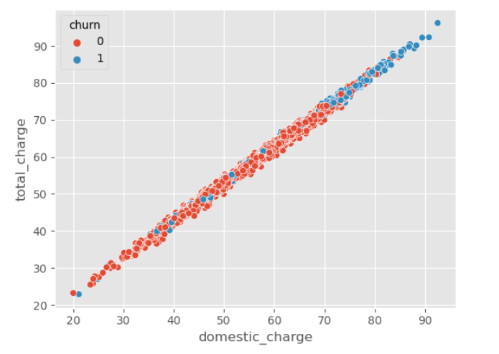
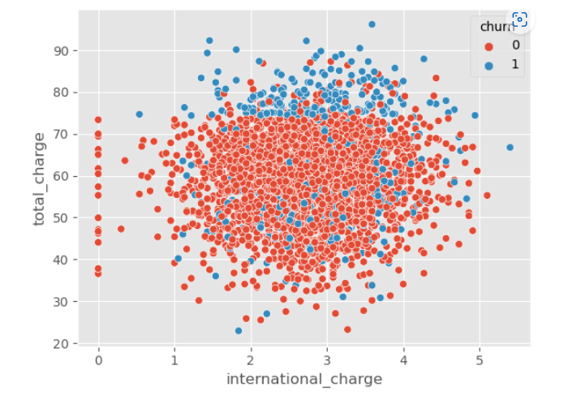
Creating new feature domestic charge which includes day, evening and night charges:
 | account_length | voice_mail_plan | voice_mail_messages | day_mins | evening_mins | night_mins | international_mins | customer_service_calls | international_plan | day_calls | day_charge | evening_calls | evening_charge | night_calls | night_charge | international_calls | international_charge | total_charge | churn | domestic_charge
0 | 128 | 1 | 25 | 265.1 | 197.4 | 244.7 | 10.0 | 1 | 0 | 110 | 45.07 | 99 | 16.78 | 91 | 11.01 | 3 | 2.70 | 75.56 | 0 | 72.86
1 | 107 | 1 | 26 | 161.6 | 195.5 | 254.4 | 13.7 | 1 | 0 | 123 | 27.47 | 103 | 16.62 | 103 | 11.45 | 3 | 3.70 | 59.24 | 0 | 55.54
2 | 137 | 0 | 0 | 243.4 | 121.2 | 162.6 | 12.2 | 0 | 0 | 114 | 41.38 | 110 | 10.30 | 104 | 7.32 | 5 | 3.29 | 62.29 | 0 | 59.00
3 | 84 | 0 | 0 | 299.4 | 61.9 | 196.9 | 6.6 | 2 | 1 | 71 | 50.90 | 88 | 5.26 | 89 | 8.86 | 7 | 1.78 | 66.80 | 0 | 65.02
4 | 75 | 0 | 0 | 166.7 | 148.3 | 186.9 | 10.1 | 3 | 1 | 113 | 28.34 | 122 | 12.61 | 121 | 8.41 | 3 | 2.73 | 52.09 | 0 | 49.36
By looking at the above scatter plot we can clearly see that:
Domestic charge has positive linear relationship with the total charge
Customers having high domestic charge (total charge) are mostly churning
Only few customers with less total charge have churned

Slide 12
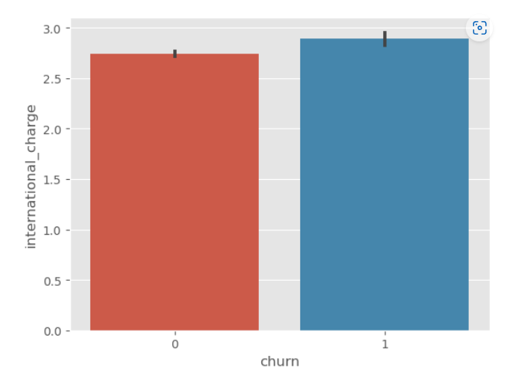
By looking at the above scatterplot and bar plot we can see that there is no linear relationship between international charge and total charge as well as International charge is not affecting the churning rate as it is approximately same for both churn and non-churn customers.
Feature Selection:

Slide 13
 | account_length | voice_mail_plan | voice_mail_messages | day_mins | evening_mins | night_mins | international_mins | customer_service_calls | international_plan | day_calls | day_charge | evening_calls | evening_charge | night_calls | night_charge | international_calls | international_charge | total_charge
account_length | 1.000000 | 0.002918 | -0.004628 | 0.006216 | -0.006757 | -0.008955 | 0.009514 | -0.003796 | 0.024735 | 0.038470 | 0.006214 | 0.019260 | -0.006745 | -0.013176 | -0.008960 | 0.020661 | 0.009546 | 0.001454
voice_mail_plan | 0.002918 | 1.000000 | 0.956927 | -0.001684 | 0.021545 | 0.006079 | -0.001318 | -0.017824 | 0.006006 | -0.011086 | -0.001686 | -0.006444 | 0.021559 | 0.015553 | 0.006064 | 0.007618 | -0.001276 | 0.008585
voice_mail_messages | -0.004628 | 0.956927 | 1.000000 | 0.000778 | 0.017562 | 0.007681 | 0.002856 | -0.013263 | 0.008745 | -0.009548 | 0.000776 | -0.005864 | 0.017578 | 0.007123 | 0.007663 | 0.013957 | 0.002884 | 0.009766
day_mins | 0.006216 | -0.001684 | 0.000778 | 1.000000 | 0.007043 | 0.004323 | -0.010155 | -0.013423 | 0.049396 | 0.006750 | 1.000000 | 0.015769 | 0.007029 | 0.022972 | 0.004300 | 0.008033 | -0.010092 | 0.884754
evening_mins | -0.006757 | 0.021545 | 0.017562 | 0.007043 | 1.000000 | -0.012584 | -0.011035 | -0.012985 | 0.019100 | -0.021451 | 0.007050 | -0.011430 | 1.000000 | 0.007586 | -0.012593 | 0.002541 | -0.011067 | 0.413143
night_mins | -0.008955 | 0.006079 | 0.007681 | 0.004323 | -0.012584 | 1.000000 | -0.015207 | -0.009288 | -0.028905 | 0.022938 | 0.004324 | -0.002093 | -0.012592 | 0.011204 | 0.999999 | -0.012353 | -0.015180 | 0.214257
international_mins | 0.009514 | -0.001318 | 0.002856 | -0.010155 | -0.011035 | -0.015207 | 1.000000 | -0.009640 | 0.045871 | 0.021565 | -0.010157 | 0.008703 | -0.011043 | -0.013605 | -0.015214 | 0.032304 | 0.999993 | 0.054988
customer_service_calls | -0.003796 | -0.017824 | -0.013263 | -0.013423 | -0.012985 | -0.009288 | -0.009640 | 1.000000 | -0.024522 | -0.018942 | -0.013427 | 0.002423 | -0.012987 | -0.012802 | -0.009277 | -0.017561 | -0.009675 | -0.019873
international_pla | 0.024735 | 0.006006 | 0.008745 | 0.049396 | 0.019100 | -0.028905 | 0.045871 | -0.024522 | 1.000000 | 0.003755 | 0.049398 | 0.006114 | 0.019106 | 0.012451 | -0.028913 | 0.017366 | 0.045780 | 0.048415
day_calls | 0.038470 | -0.011086 | -0.009548 | 0.006750 | -0.021451 | 0.022938 | 0.021565 | -0.018942 | 0.003755 | 1.000000 | 0.006753 | 0.006462 | -0.021449 | -0.019557 | 0.022927 | 0.004574 | 0.021666 | 0.003673
day_charge | 0.006214 | -0.001686 | 0.000776 | 1.000000 | 0.007050 | 0.004324 | -0.010157 | -0.013427 | 0.049398 | 0.006753 | 1.000000 | 0.015769 | 0.007036 | 0.022972 | 0.004301 | 0.008032 | -0.010094 | 0.884757
evening_calls | 0.019260 | -0.006444 | -0.005864 | 0.015769 | -0.011430 | -0.002093 | 0.008703 | 0.002423 | 0.006114 | 0.006462 | 0.015769 | 1.000000 | -0.011423 | 0.007710 | -0.002056 | 0.017434 | 0.008674 | 0.009392
evening_charge | -0.006745 | 0.021559 | 0.017578 | 0.007029 | 1.000000 | -0.012592 | -0.011043 | -0.012987 | 0.019106 | -0.021449 | 0.007036 | -0.011423 | 1.000000 | 0.007596 | -0.012601 | 0.002541 | -0.011074 | 0.413129
night_calls | -0.013176 | 0.015553 | 0.007123 | 0.022972 | 0.007586 | 0.011204 | -0.013605 | -0.012802 | 0.012451 | -0.019557 | 0.022972 | 0.007710 | 0.007596 | 1.000000 | 0.011188 | 0.000305 | -0.013630 | 0.024818
night_charge | -0.008960 | 0.006064 | 0.007663 | 0.004300 | -0.012593 | 0.999999 | -0.015214 | -0.009277 | -0.028913 | 0.022927 | 0.004301 | -0.002056 | -0.012601 | 0.011188 | 1.000000 | -0.012329 | -0.015186 | 0.214233
international_calls | 0.020661 | 0.007618 | 0.013957 | 0.008033 | 0.002541 | -0.012353 | 0.032304 | -0.017561 | 0.017366 | 0.004574 | 0.008032 | 0.017434 | 0.002541 | 0.000305 | -0.012329 | 1.000000 | 0.032372 | 0.007776
international_charge | 0.009546 | -0.001276 | 0.002884 | -0.010092 | -0.011067 | -0.015180 | 0.999993 | -0.009675 | 0.045780 | 0.021666 | -0.010094 | 0.008674 | -0.011074 | -0.013630 | -0.015186 | 0.032372 | 1.000000 | 0.055036
total_charge | 0.001454 | 0.008585 | 0.009766 | 0.884754 | 0.413143 | 0.214257 | 0.054988 | -0.019873 | 0.048415 | 0.003673 | 0.884757 | 0.009392 | 0.413129 | 0.024818 | 0.214233 | 0.007776 | 0.055036 | 1.000000

